Slide 1
Documenting REST Services

Slide 2
Objectives
API Documentation
Key elements of Spring REST documents
Using Swagger 3 in Spring Boot 3
The implementation of Swagger 3 in Spring Boot
Demo 1 - Simple Documenting REST API
Demo 2 - Customize the REST with Swagger

Slide 3
The Importance of API Documentation
Documenting REST services is the process of creating clear and concise documentation that explains how to interact with a RESTful API. This documentation serves as a guide for developers who want to use the API, ensuring they understand its functionality, endpoints, request/response formats, and other relevant information.
Clarity for Developers: Understand API functionalities and usage. Well-documented APIs make it easier for developers to understand and use the service, leading to faster integration and reduced frustration
Reduced Integration Errors: Minimize misunderstandings and inconsistencies.
Enhanced Collaboration: Facilitate communication between teams.

Slide 4
Introduction to Spring REST Documents
Test-Driven Approach: Generate documentation from your existing Spring tests.
Accuracy and Reliability: Documentation always stays in sync with your code.
Asciidoctor Integration: Produce human-readable documentation in various formats (HTML, PDF).
Minimal Code Intrusion: Keep your code clean and focused on business logic.
Extensible and Customizable: Tailor the output to your specific needs.

Slide 5
Key elements - 1
Introduction - A brief overview of the API, its purpose, and target audience.
Authentication and Authorization - How developers can authenticate and authorize their requests to access the API.
Endpoints - A list of all available endpoints, including their HTTP methods (GET, POST, PUT, DELETE, etc.) and URL paths.
Request Parameters - A description of the parameters that can be included in requests, such as query parameters, headers, and request bodies.
Response Formats - The format of the responses returned by the API, such as JSON or XML.

Slide 6
Key elements - 2
Error Handling - How the API handles errors and what error codes or messages are returned.
Rate Limiting - Any rate limits or usage quotas that apply to the API.
Versioning - How the API is versioned and how to handle changes between versions.

Slide 7
Using Swagger 3 in Spring Boot 3
OpenAPI 3: Swagger is based on the OpenAPI Specification (formerly known as Swagger Specification). Version 3 brings significant improvements:
Supports more complex data types and API structures.
Better support for defining and documenting API security schemes.
Allows for defining reusable components and schemas.
Spring Boot 3 Integration:
springdoc-openapi: The recommended library
Automatic Generation: Effortlessly generate OpenAPI documentation from your Spring Boot application's code.
Easy Configuration: Simple setup and customization options.

Slide 8
Benefits of Swagger 3
Swagger is an open-source framework for designing, building, documenting, and consuming RESTful APIs.
Reduced Development Time: Faster API development with clear documentation and testing capabilities.
Improved Code Quality: Encourages better API design and consistency.
Enhanced Collaboration: Facilitates seamless communication between teams.
Simplified API Consumption: Makes it easier for other developers to understand and use your API.

Slide 9
How to implement Swagger 3 in Spring Boot
Step 1. Add the springdoc-openapi dependency
Step 2. Annotate the code
Controller Annotations in OpenAPI 3
Method Annotations in OpenAPI 3
Model Annotations in OpenAPI 3
Step 3. (Optional) Customize the OpenAPI definition
Step 4. Access the Swagger UI
Step 5. Explore and interact with RESTful API

Slide 10
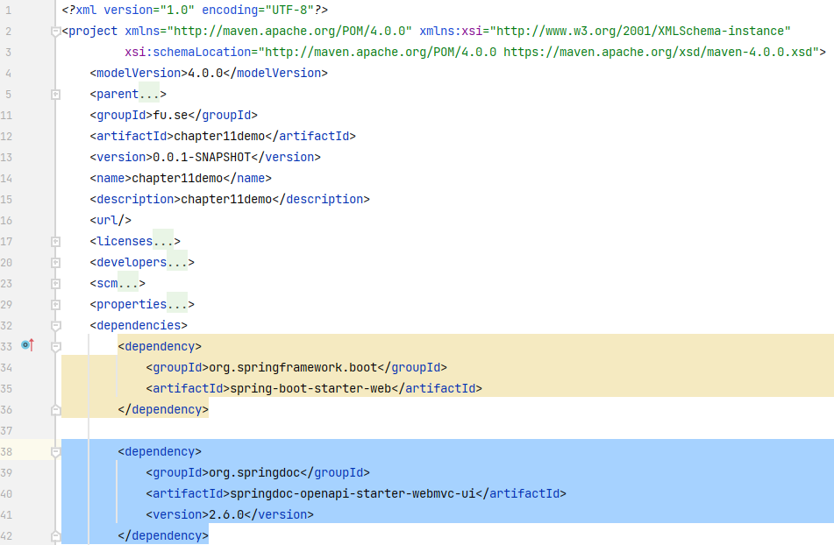
Step 1. Add springdoc-openapi dependency
pom.xml file
Notes:
https://mvnrepository.com/artifact/org.springdoc/springdoc-openapi-starter-webmvc-ui

Slide 11
Step 2. Controller Annotations in OpenAPI 3
@Tag: Used to group operations together. This helps organize your API documentation.
name: The name of the tag. This is displayed in the Swagger UI.
description: A description of the tag.
@SecurityScheme: Defines a security scheme that can be used by operations. Common schemes include OAuth2, API keys, and HTTP Basic authentication.
name: The name of the security scheme.
type: The type of security scheme (e.g., apiKey, http, oauth2, openIdConnect).
scheme: The authentication scheme (e.g., basic for HTTP Basic).
bearerFormat: The bearer format for OAuth2 (e.g., JWT).
in: Where the security information is passed (e.g., header, query, cookie).

Slide 12
Step 2. Method Annotations in OpenAPI 3 - 1
@Operation: Describes a single API operation on a path.
summary: A short summary of what the operation does.
description: A verbose explanation of the operation behavior.
operationId: A unique string used to identify the operation.
tags: An array of tags for the operation.
requestBody: Describes the request body.
responses: Describes the possible responses.
parameters: Describes the operation parameters.
security: Declares the security schemes used by the operation.
deprecated: Marks the operation as deprecated.

Slide 13
Step 2. Method Annotations in OpenAPI 3 - 2
@ApiResponse: Describes a possible response.
responseCode: The HTTP status code of the response.
description: A short description of the response.
content: Describes the response body content.
headers: Describes the response headers.
@Parameter: Describes an operation parameter.
name: The name of the parameter.
in: Where the parameter is located (e.g., path, query, header, cookie).
description: A description of the parameter.
required: Whether the parameter is required.
schema: Describes the data type of the parameter.

Slide 14
Step 2. Method Annotations in OpenAPI 3 - 3
@RequestBody: Describes the request body of an operation.
description: A description of the request body.
required: Whether the request body is required.
content: Describes the content of the request body.

Slide 15
Step 2. Model Annotations in OpenAPI 3
@Schema: Describes a model or data type.
name: The name of the schema.
description: A description of the schema.
type: The data type of the schema (e.g., string, integer, object, array).
format: The format of the data type (e.g., email, date, date-time).
implementation: The class that implements the schema.
properties: Describes the properties of an object schema.
example: Provides an example value for the schema.

Slide 16
Step 3. Customize the OpenAPI definition - 1
@Configuration: This annotation indicates that the class is a Spring configuration class.
@Bean: This annotation tells Spring to create a bean of type OpenAPI and make it available for dependency injection. This is how developer can register custom OpenAPI configuration.
OpenAPI object: This is the root object of your OpenAPI specification.

Slide 17
Step 3. Customize the OpenAPI definition - 2
info property:
title: Sets the title of your API documentation.
version: Specifies the API version.
description: Provides a detailed description of your API.
termsOfService: A URL to the terms of service for the API.
contact: Contact information for the API support.
license: License information for the API.

Slide 18
Step 3. Customize the OpenAPI definition - 3
servers property (optional):
Allows you to define multiple server URLs for your API. This is useful if you have different environments (e.g., development, staging, production).
The @Value annotation injects the value of springdoc.api-docs.path (which is usually /v3/api-docs by default) to construct the server URLs correctly.
Change the value of springdoc.api-docs.path in application.properties

Slide 19
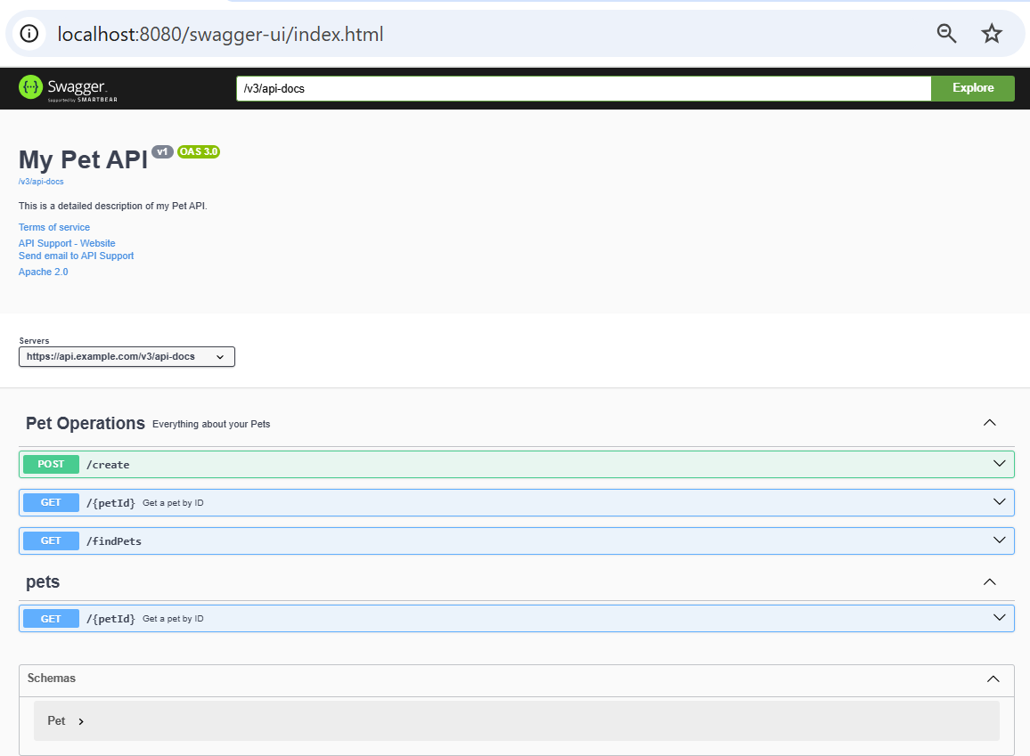
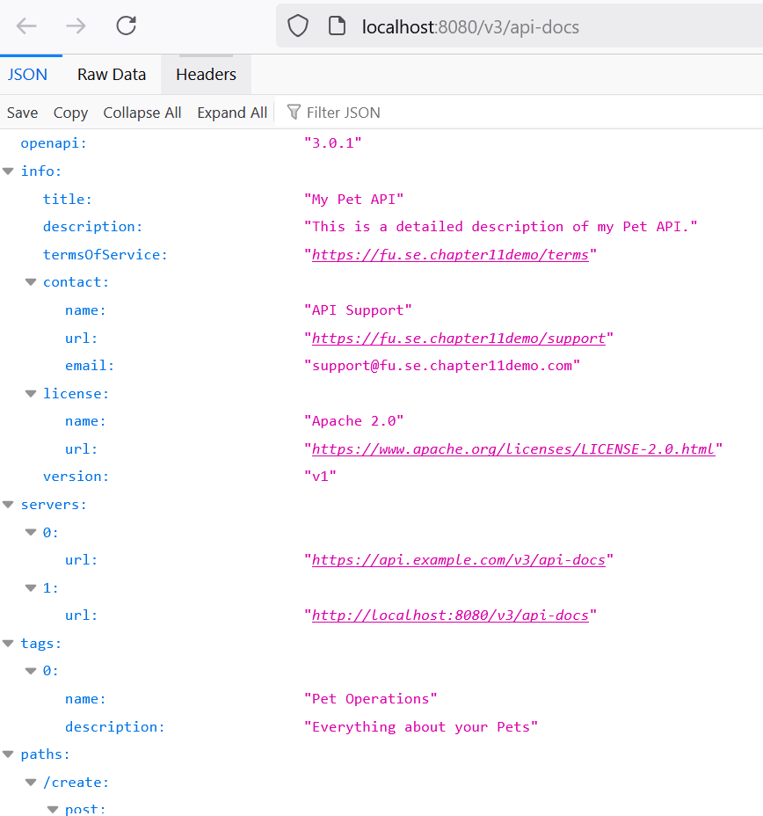
Step 4, 5

Slide 20
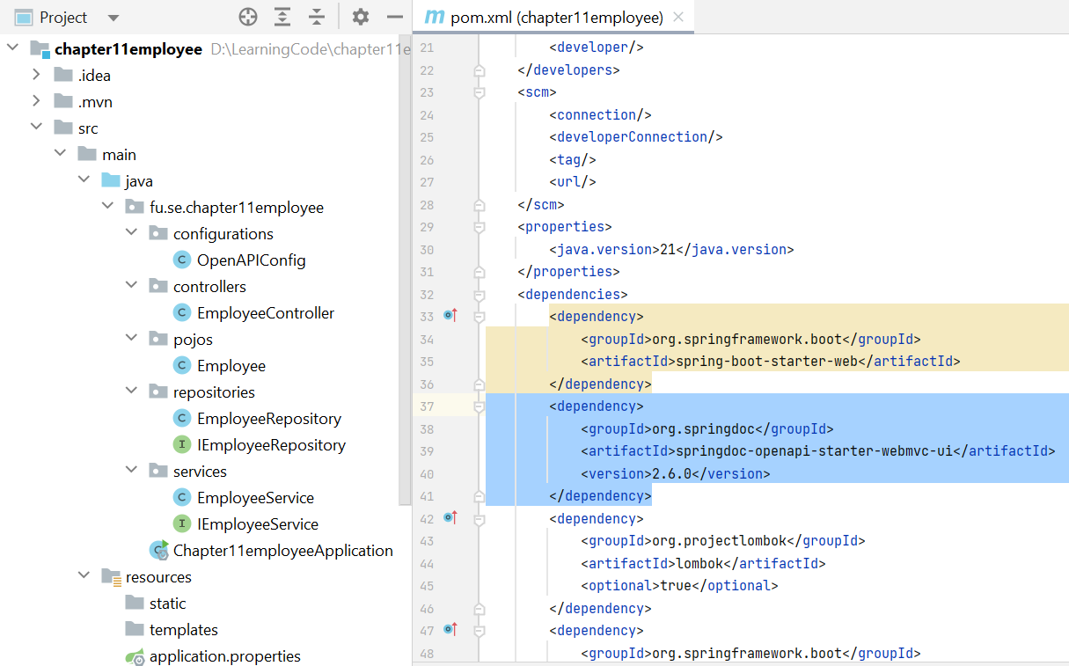
Demo 1 - Simple Documenting REST API
Create Spring Boot project with Spring Web
Add project dependency with org.springdoc
Create Employee class
Create REST controller
Run the project

Slide 21
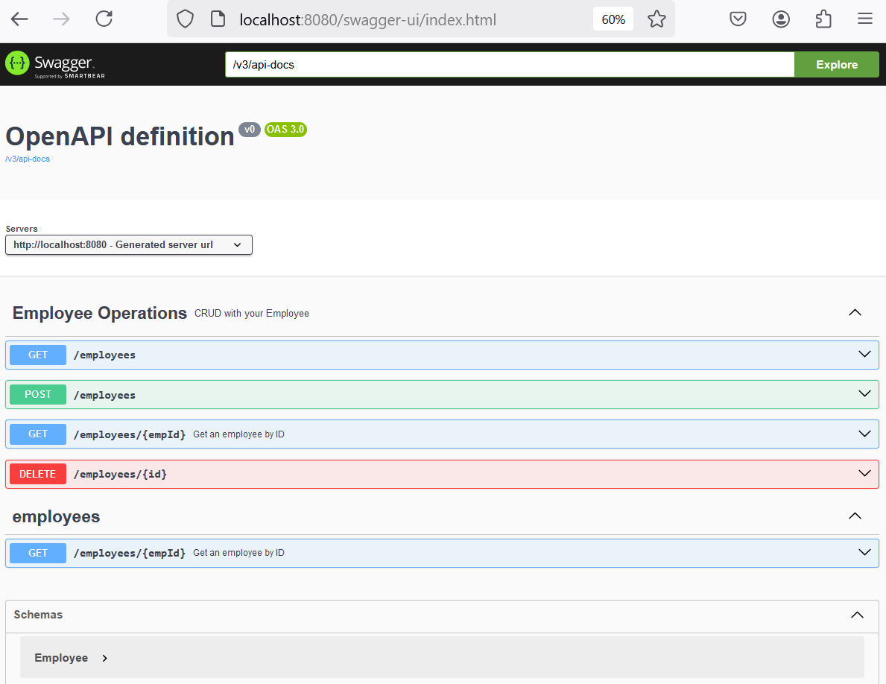
Demo 1 - Simple Documenting REST API

Slide 22
Demo 2 - Customize the REST with Swagger
Option 1.
@OpenAPIDefinition(info = @Info(title = "Employees API", version = "2.0", description = "Employees Information")) in @SpringBootApplication class
Option 2. Create a class with @Configuration annotation

Slide 23
Demo 2 (contd.)
1. Project Setup
Create a Spring Boot project in IntelliJ IDEA
Add dependencies in your pom.xml (Maven)
spring-boot-starter-web (for RESTful API controllers)
springdoc-openapi-starter-webmvc-ui (for Swagger 3 integration)

Slide 24
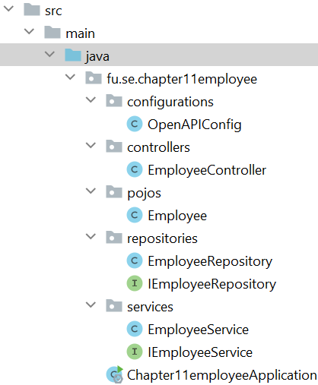
Demo 2 (contd.)
2. Create the 3-Layer Architecture packages
Package controllers: For REST controllers that handle API requests.
Package services: For business logic and service classes.
Package repositories: For data access objects (DAOs) or repositories that interact with the data source (in this case, the data source is the collection).

Slide 25
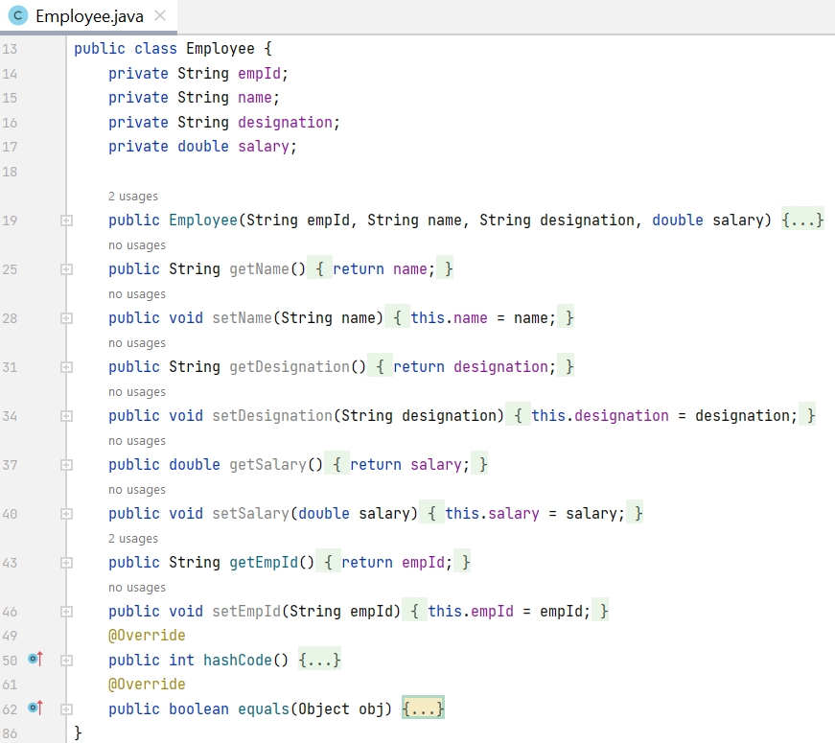
Demo 2 (contd.)
3. Implement the Data Layer (repositories)
Create domain model to represent employee information.
Create a repository interface to perform CRUD operations on employee entity.

Slide 26
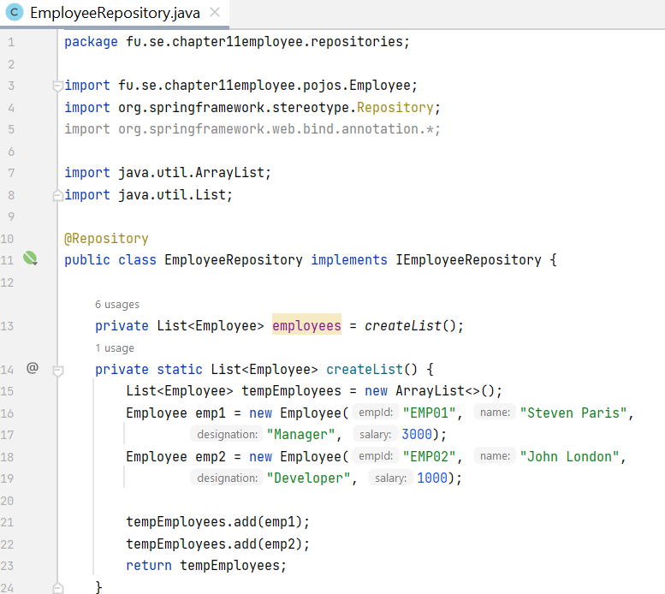
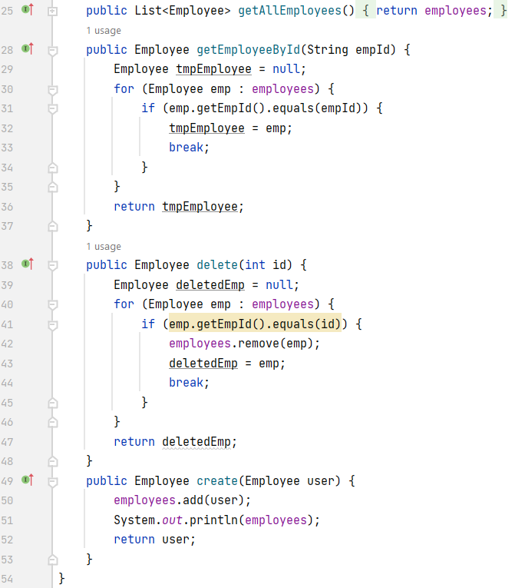
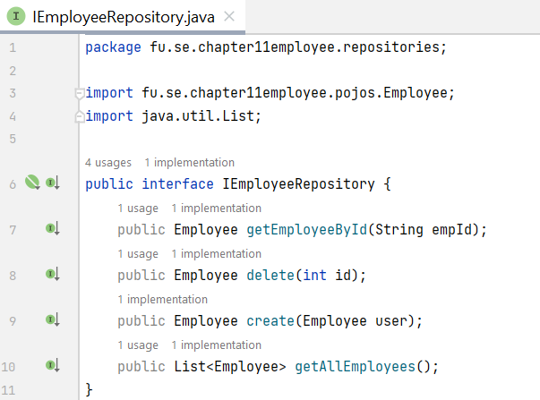
Demo 2 (contd.)

Slide 27
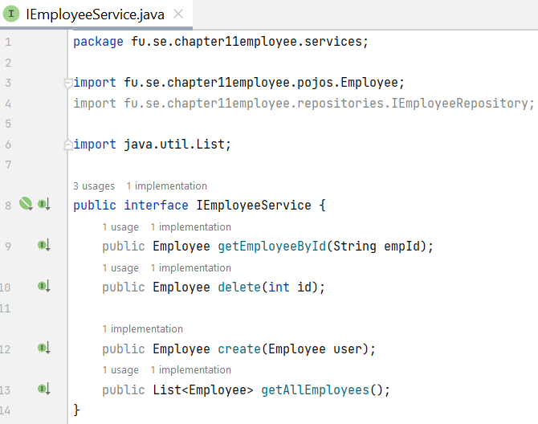
Demo 2 (contd.)
4. Implement the Service Layer (services)
Define an interface for IEmployeeService.
Implement the service class EmployeeService. This class implements the service interface with business logic, using the repository to access data.

Slide 28
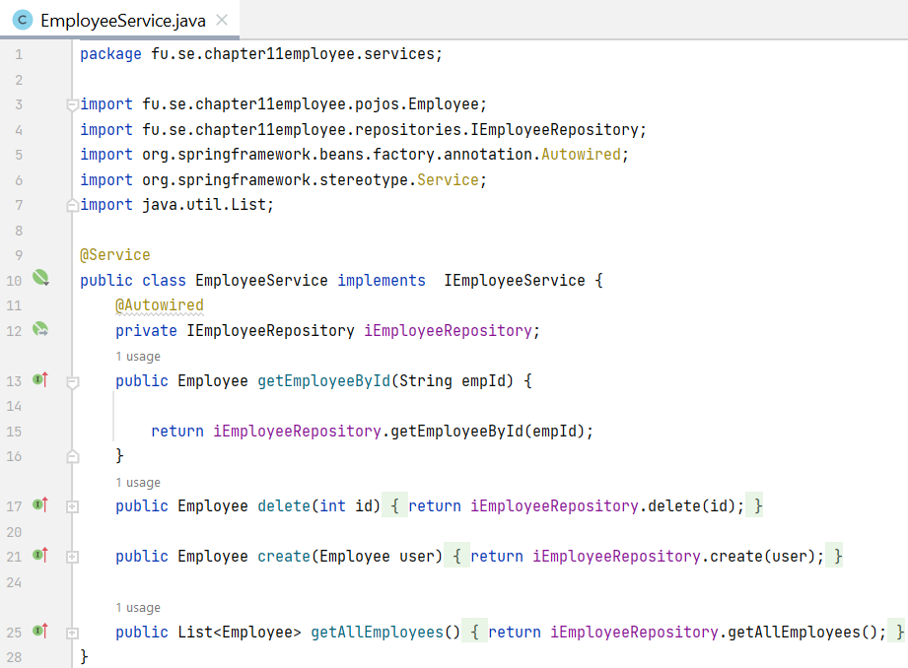
Demo 2 (contd.)

Slide 29
Demo 2 (contd.)
5. Implement the Controller Layer (controllers)
Create a REST controller: Use @RestController to define a controller that handles API requests.
Inject the service: Inject the service class into your controller.
Define API endpoints: Use @GetMapping, @PostMapping, etc., to define endpoints and map them to controller methods.

Slide 30
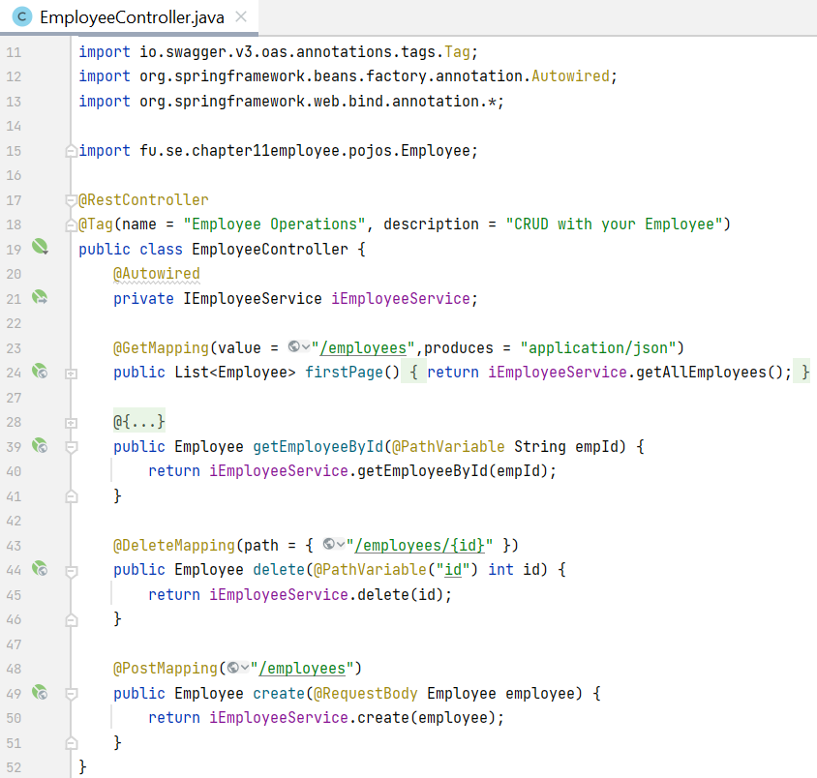
Demo 2 (contd.)

Slide 31
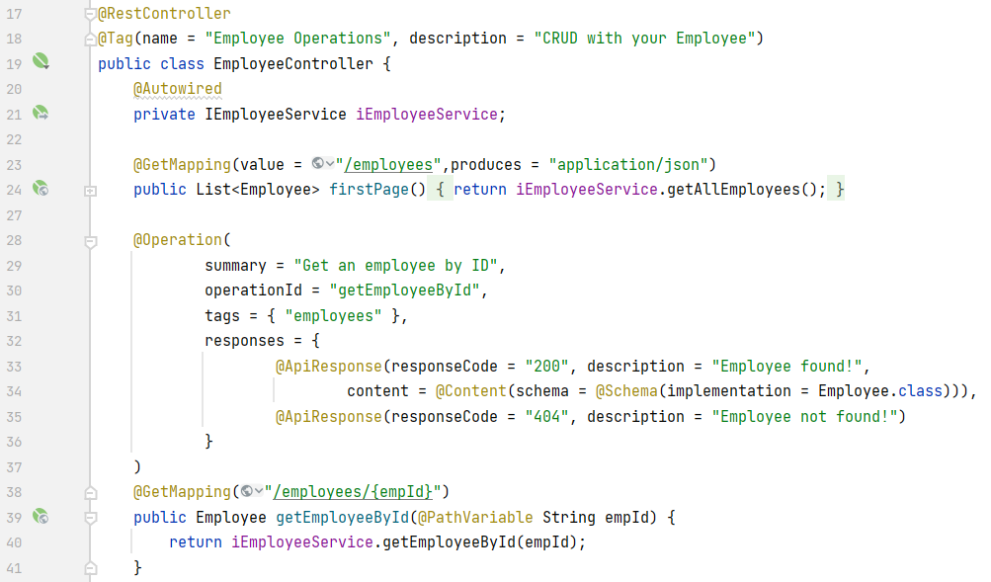
Demo 2 (contd.)
6. Add Swagger annotations to document the REST API controller

Slide 32
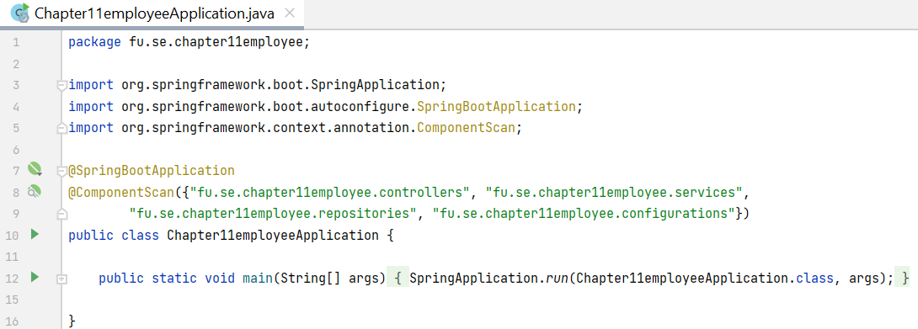
Demo 2 (contd.)
7. Using @ComponentScan in the Spring Boot Application class

Slide 33
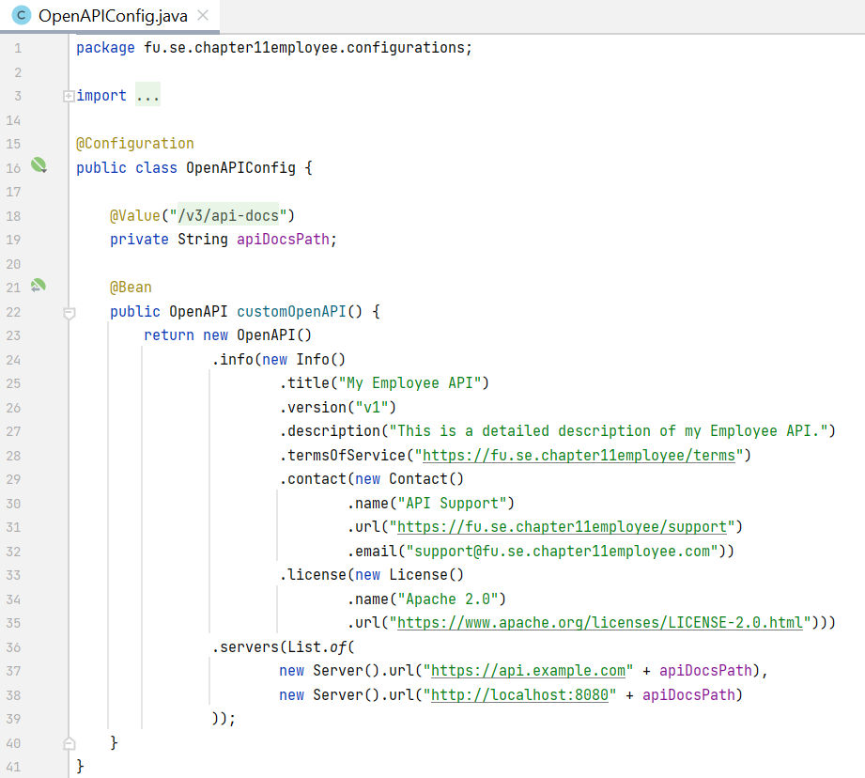
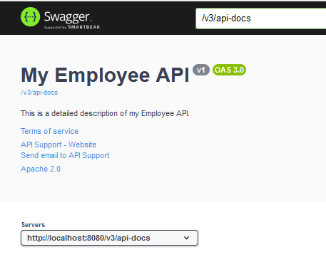
Demo 2 (contd.)
8. Customize OpenAPI Definition

Slide 34
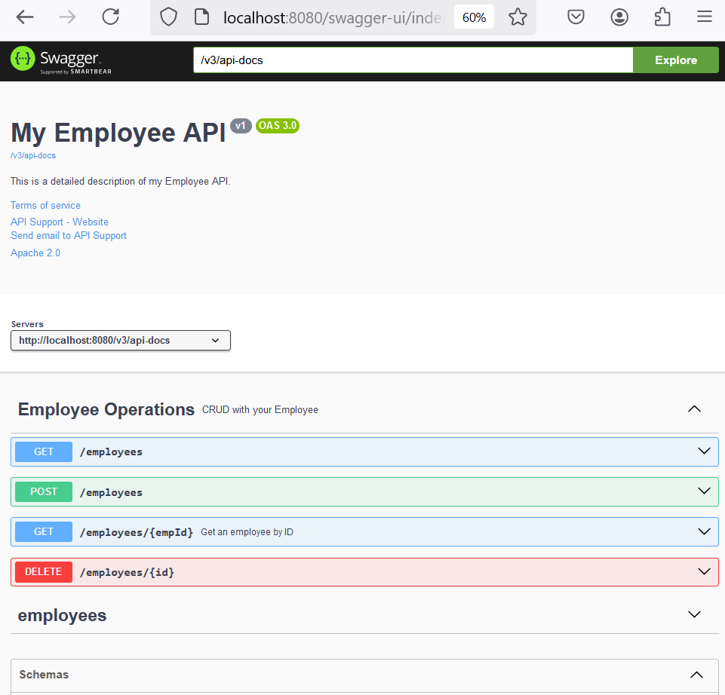
Demo 2 (contd.)
9. Run and Access Swagger UI
Run the Spring Boot application.
Open a web browser and navigate to http://localhost:8080/swagger-ui/index.html

Slide 35
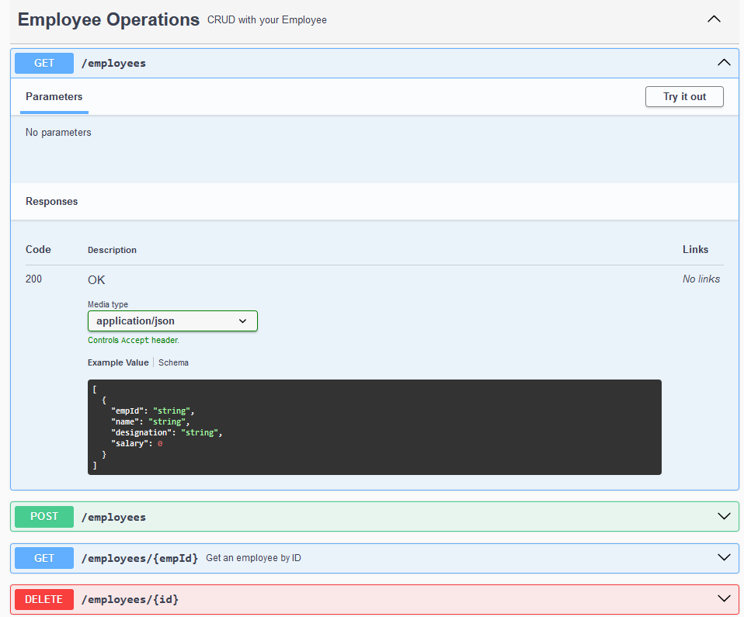
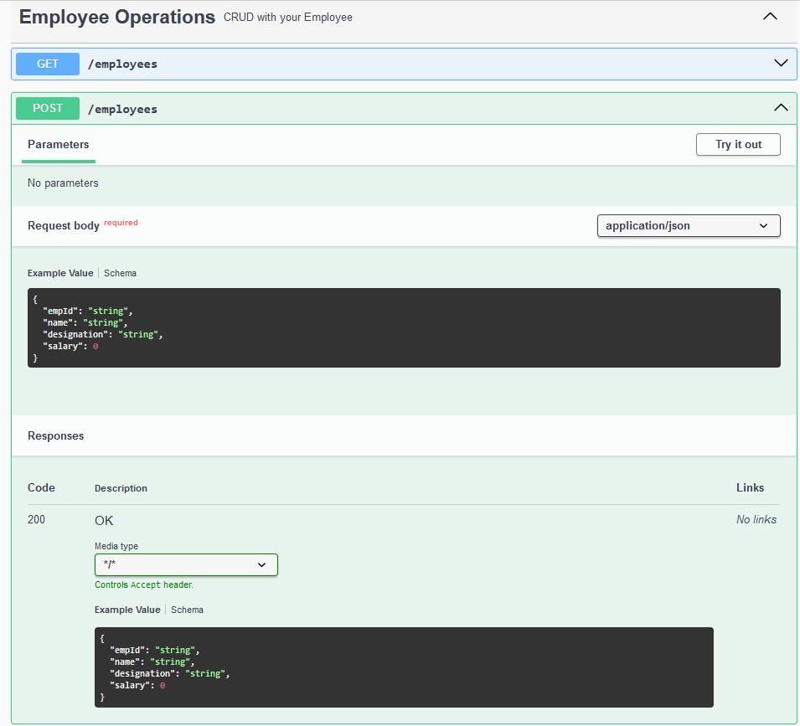
Demo 2 (contd.)

Slide 36
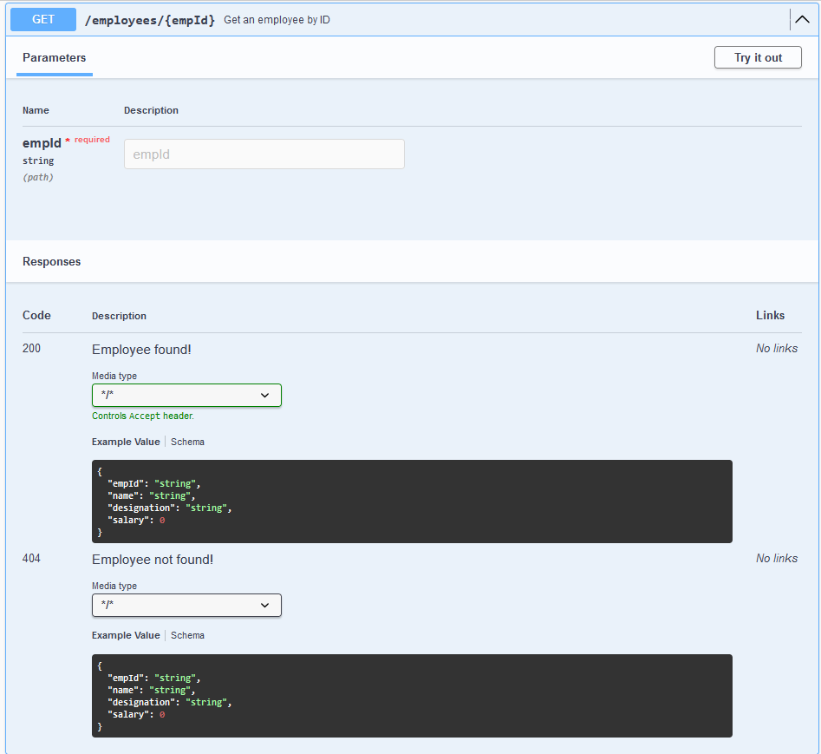
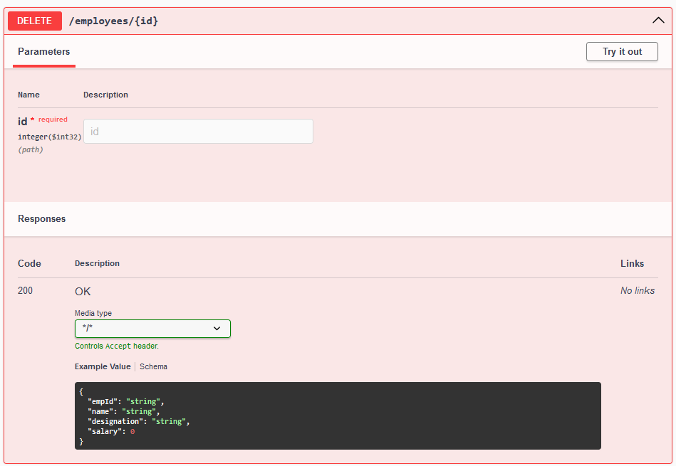
Demo 2 (contd.)

Slide 37
Summary
Concepts were introduced:
API Documentation
Key elements of Spring REST documents
Using Swagger 3 in Spring Boot 3
The implementation of Swagger 3 in Spring Boot
Demo 1 - Simple Documenting REST API
Demo 2 - Customize the REST with Swagger

